Slide 1
Assignment 6 Socket Communication
Presented by: Pranay S Nambiar

Slide 2
Socket Communication
A socket enables a device to send and receive data over a network.
TCP sockets are used for reliable connections, e.g., sending data to a web server.
LTE and GSM modules can use AT commands to create and manage sockets.

Slide 3
Common Socket AT Commands (Quectel EC25)
Command | Description
AT+CGDCONT=1,"IP","airtelgprs.com" | Set APN (PDP context)
AT+QIACT=1 | Activate PDP context
AT+QIOPEN=1,0,"TCP","example.com",80,0,1 | Open TCP connection
AT+QISEND=0,20 | Send data over socket
AT+QICLOSE=0 | Close socket

Slide 4
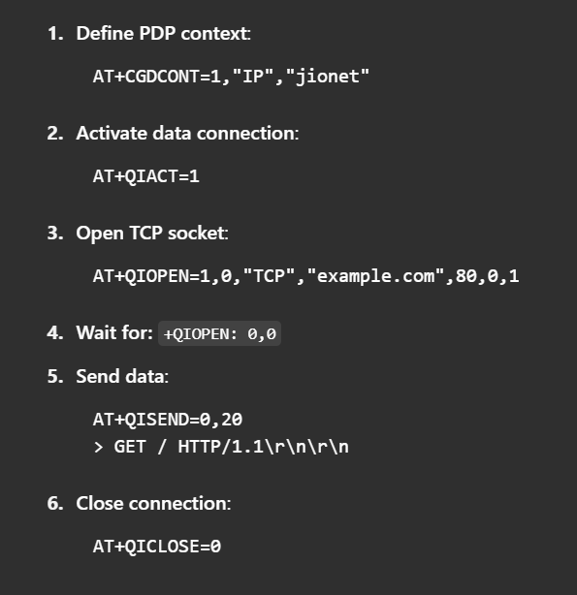
Step-by-Step Socket Setup

Slide 5
Conclusion
Socket AT commands are critical for internet-based data transmission
Understanding socket communication helps build connected IoT systems.
Emulator testing not possible; use real hardware for full validation.

